Slide 1
Deep Cancer Detection
Final Project by Muf Tayebaly (mt3195)

Slide 2
Agenda
About the project
Data Samples
Data Preprocessing
Modeling
Test Results
Conclusion
How to improve?

Slide 3
About the project

Slide 4
Project Information
This project focuses on improving the detection of cancer cells in pathology images. The detection normally is conducted by a pathologist looking at magnified images and eyeballs whether certain cells are cancerous.
The manual mistake of a person can cause for bad diagnosis and so this project helps reduce that error rate.
In order to do this, we will be using Deep Learning to train a model on the CAMELYON16 dataset to help identify if areas of the images have cancer cells.
The CAMELYON16 dataset has images of samples taken from cancer patients and where pathologists have already identified areas where cancer cells are. I will use this data to train, validate and test the model.

Slide 5
Data Preprocessing

Slide 6
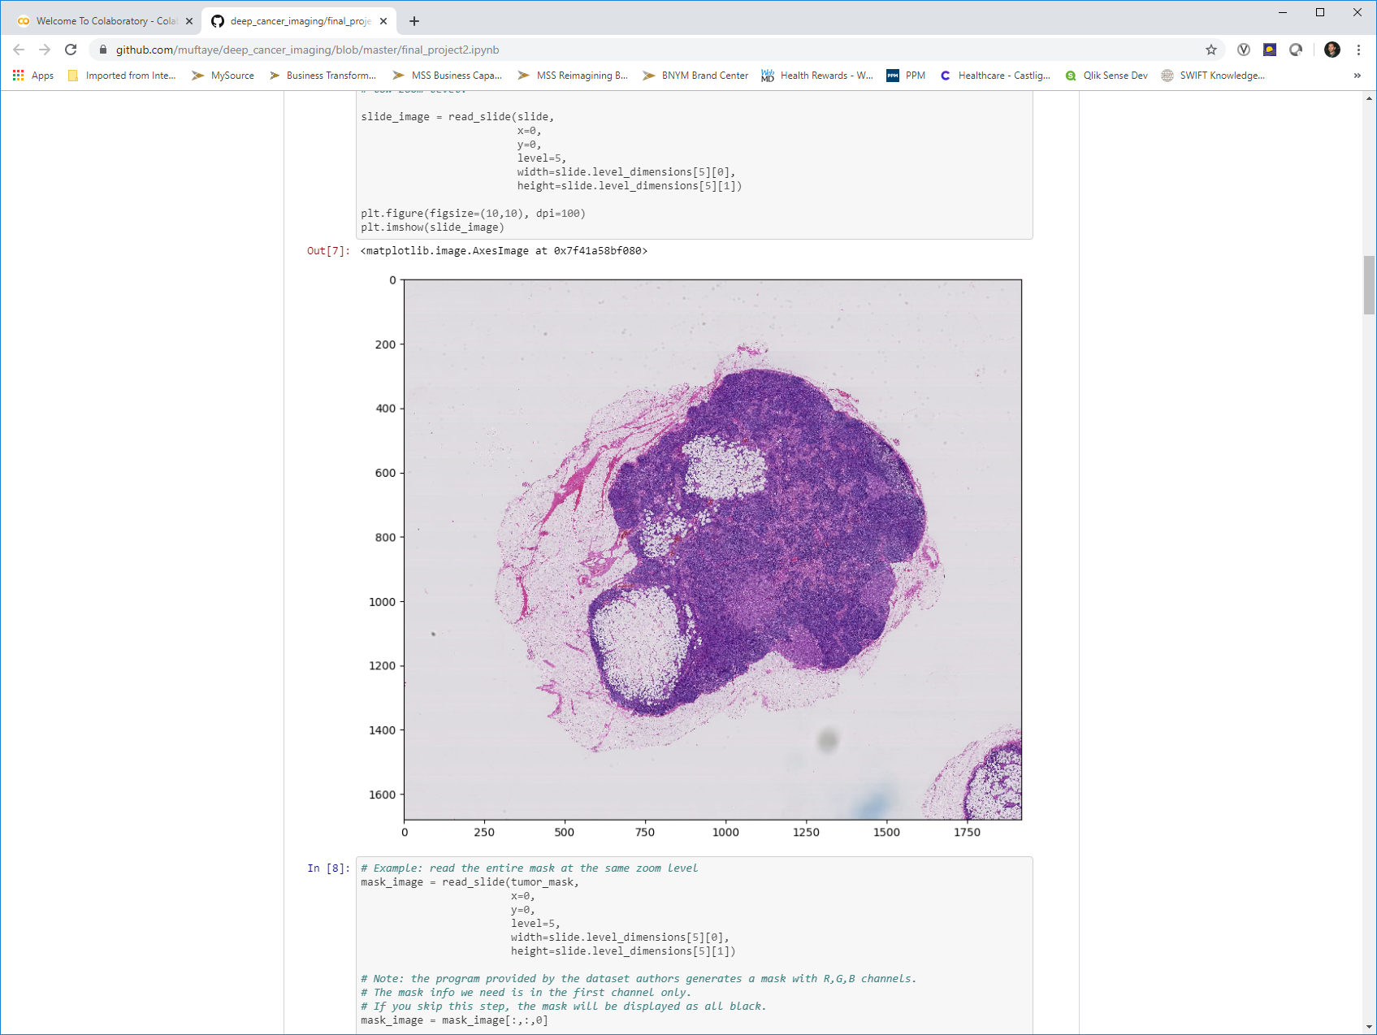
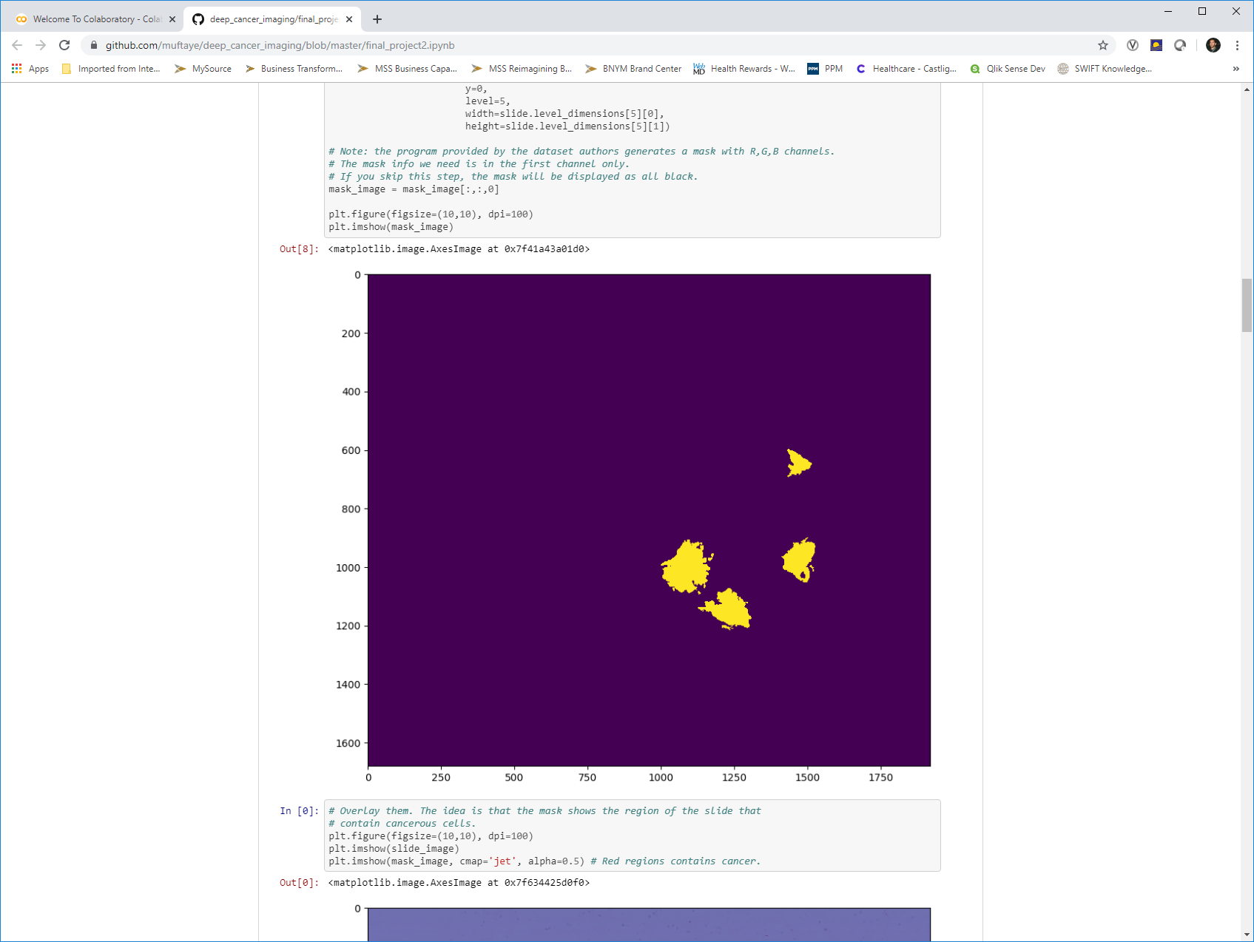
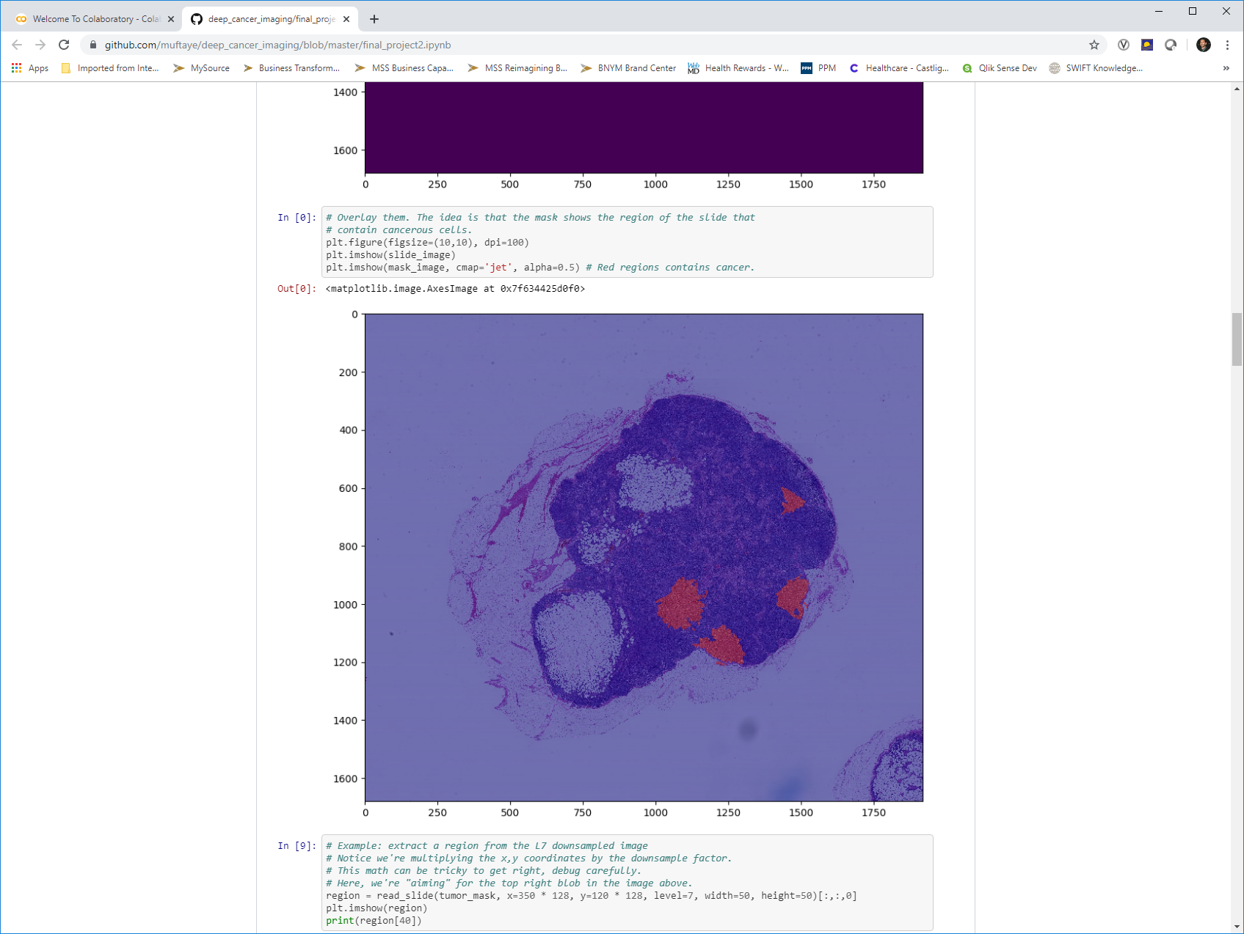
Preview the Dataset
The data consists of very large images of the sampled areas and another image that shows the areas identified as cancer. There are also different levels of each image. See below samples of the data for tumor_091 at level 5:
tumor_091 normal image with H&E
tumor_091 cancer mask
Heatmap of cancer on the tumor image

Slide 7
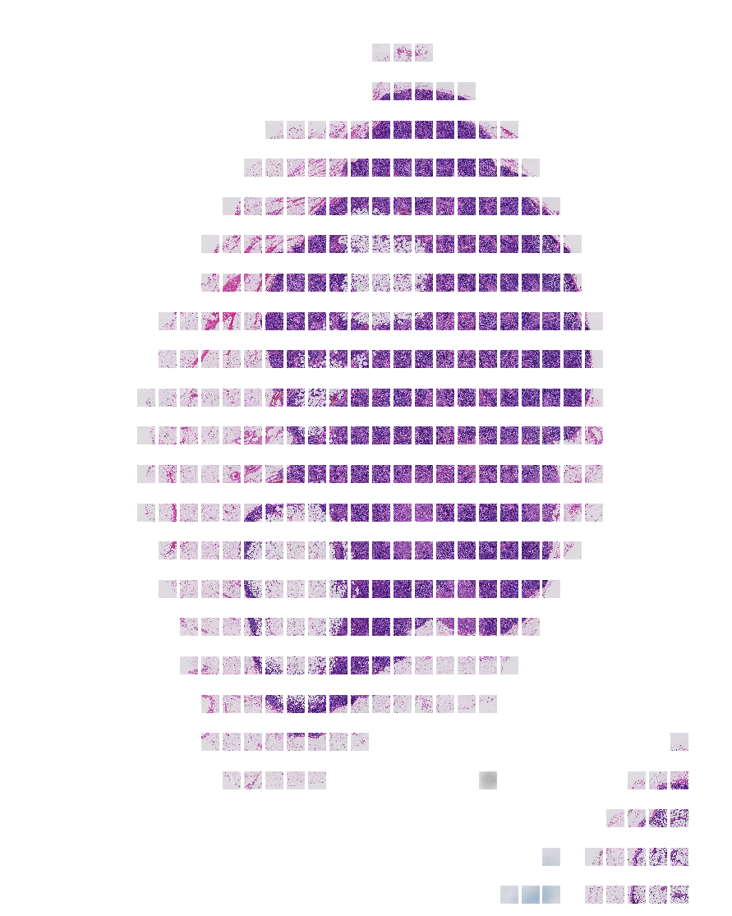
Ignoring Grey Areas – Training Efficiency
As you can see the image has a lot of space that does not contain any issue. Also, since the image is too large to train, we can use smaller patches of the images and use this opportunity to ignore the non-tissue containing patches.
After I slide through the image with a window of 128 x 128, I only keep the patches with 5% of tissue or more and as you can see, we get a much better set of data and remove all the grey space.
Creates a total of 338 patches for this tumor slide containing at least 5% tissue
tumor_091 normal image with H&E

Slide 8
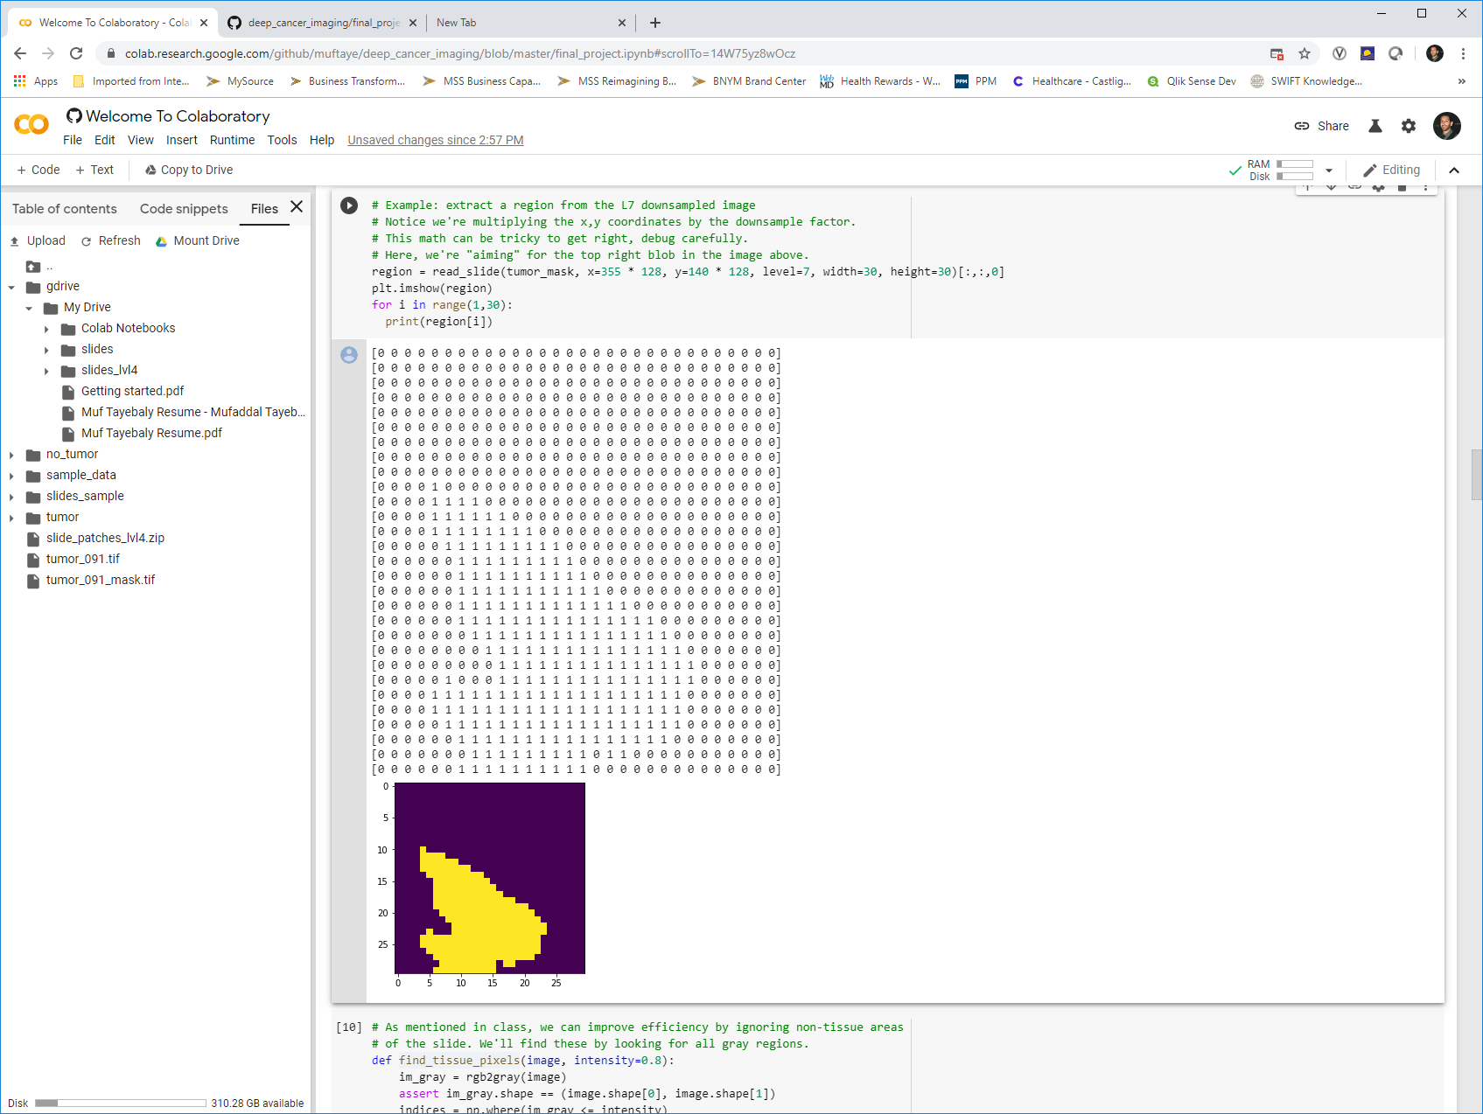
Creating the Training Set
Now that I can get the patch images, I can do the same with the mask images and determine if that patch contains cancer or not.
This is done by looking at the mask region and identifying if there is even one pixel of cancer. If there is, we classify as a cancer tumor vs no cancer tumor. This is just a simple sum of the mask matrix as shown below:
The patch matrix we sum to identify if a cancer patch
tumor_091 cancer mask in yellow

Slide 9
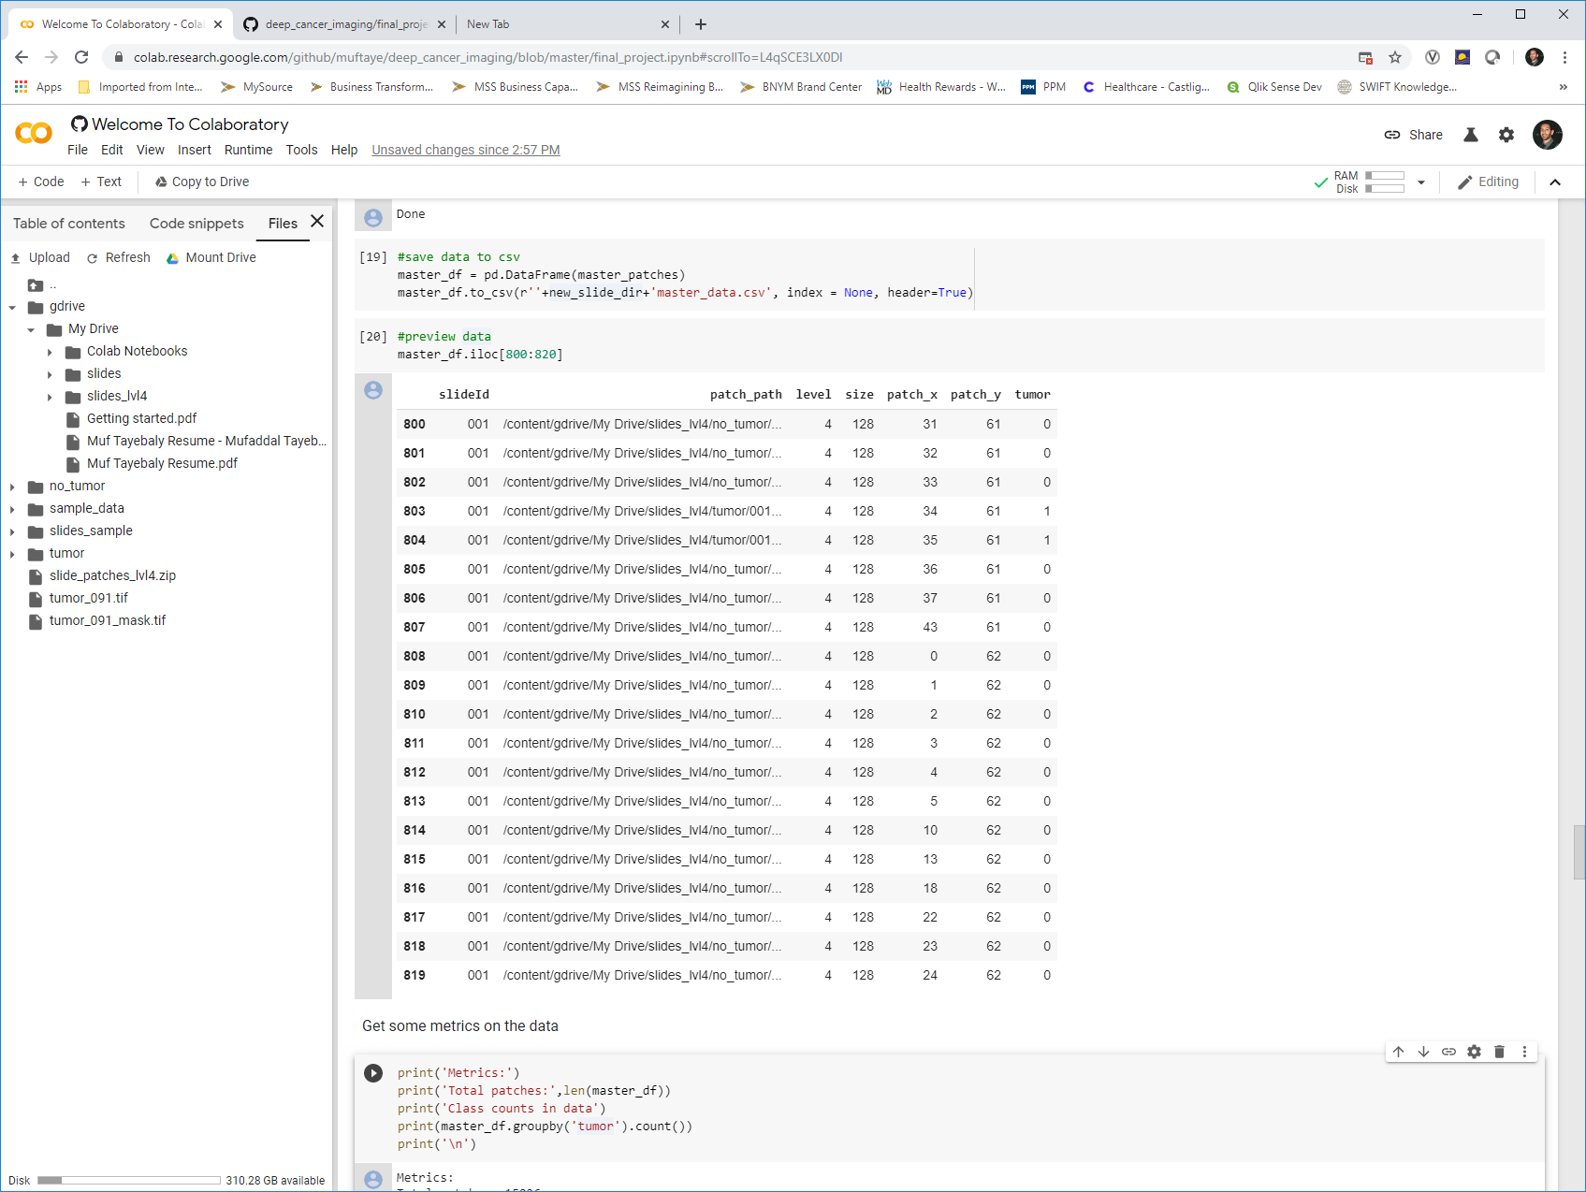
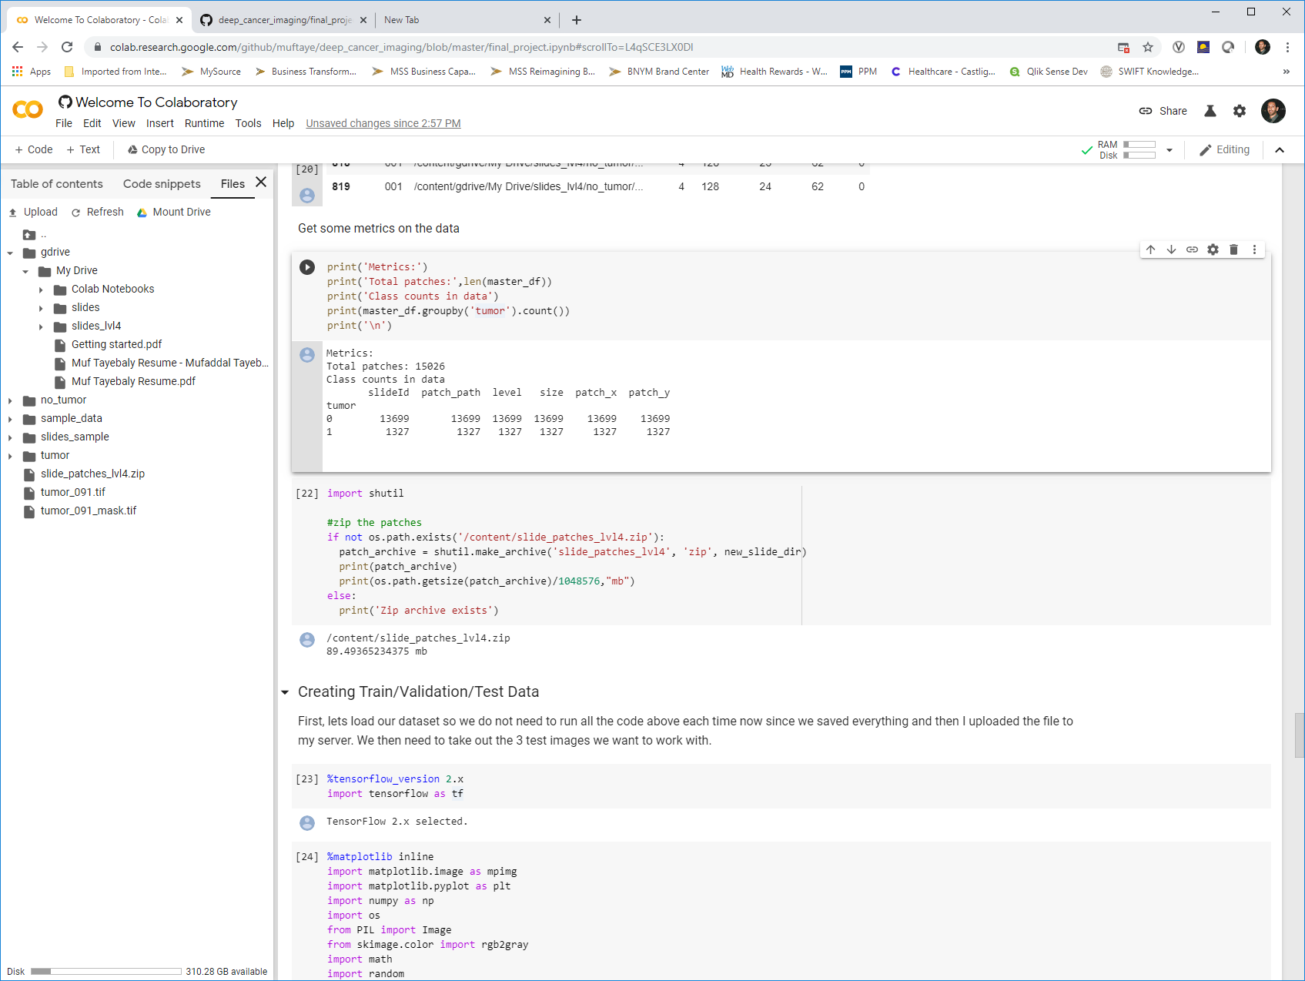
Creating the Training Set
At level 4 of the tumor images, we are able to convert all the images (except slide 099 and 038 due to missing images). We then get a training dataset as sampled below. As the metrics show, there are 15026 patches, but only 1327 of them are cancer tumor containing.

Slide 10
Creating Train / Validation / Test Data
Since I will be testing the data on 3 images, I randomly choose 3 images to pull all the data on for a complete testing. This way I have all the patches and masks, and will be able to compare the prediction on the truth with full heatmaps.
After I get the test data which contained 147 cancer containing tumors, I have 1180 left. So I need to balance the data.
This is done by randomly choose 1820 non-cancer containing tumor patches. This will give me 3000 patches to train and validate on.
I then do a 80/20 split for train and validation, which gives me the below breakdown and structure of my data ready to model.
5184 Sample Patches - Level 4
Train 2400 patches
Validation 600 patches
Test 2184 patches
Cancer - 944
No Cancer - 1456
Cancer - 236
No Cancer - 364
Cancer - 147
No Cancer - 2037

Slide 11
Modeling

Slide 12
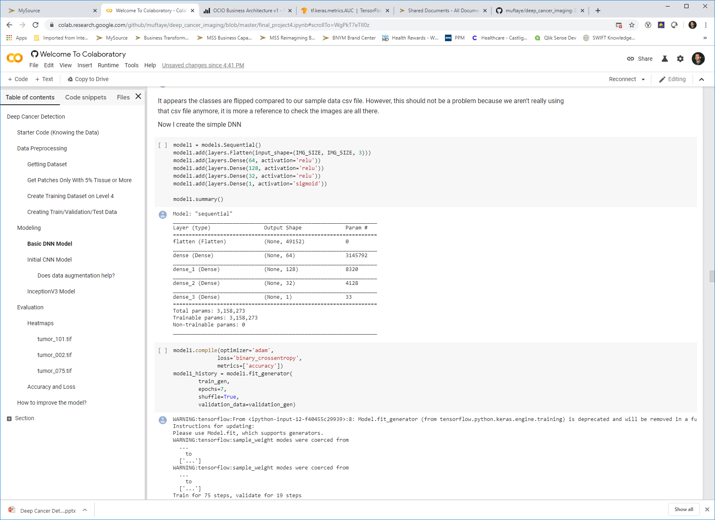
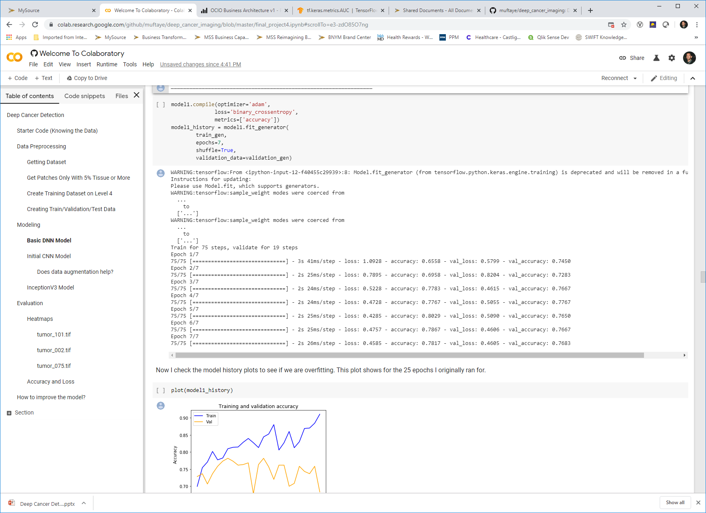
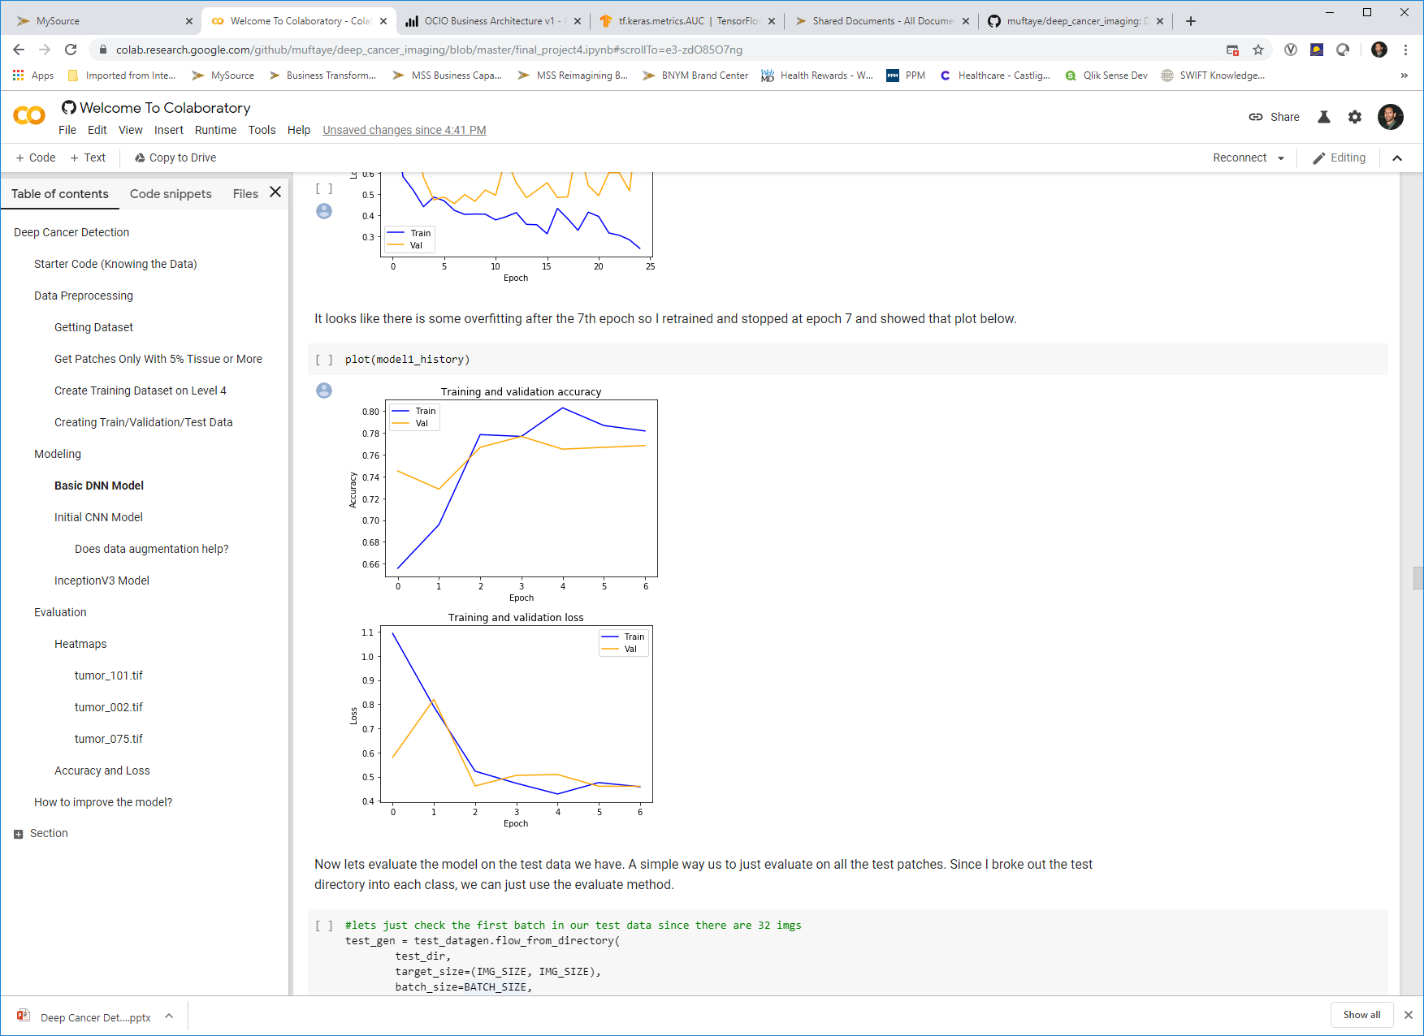
Base Model – Simple DNN with Low Parameters
I start with a simple deep learning model that can be used as a baseline as I try and improve it.

Slide 13
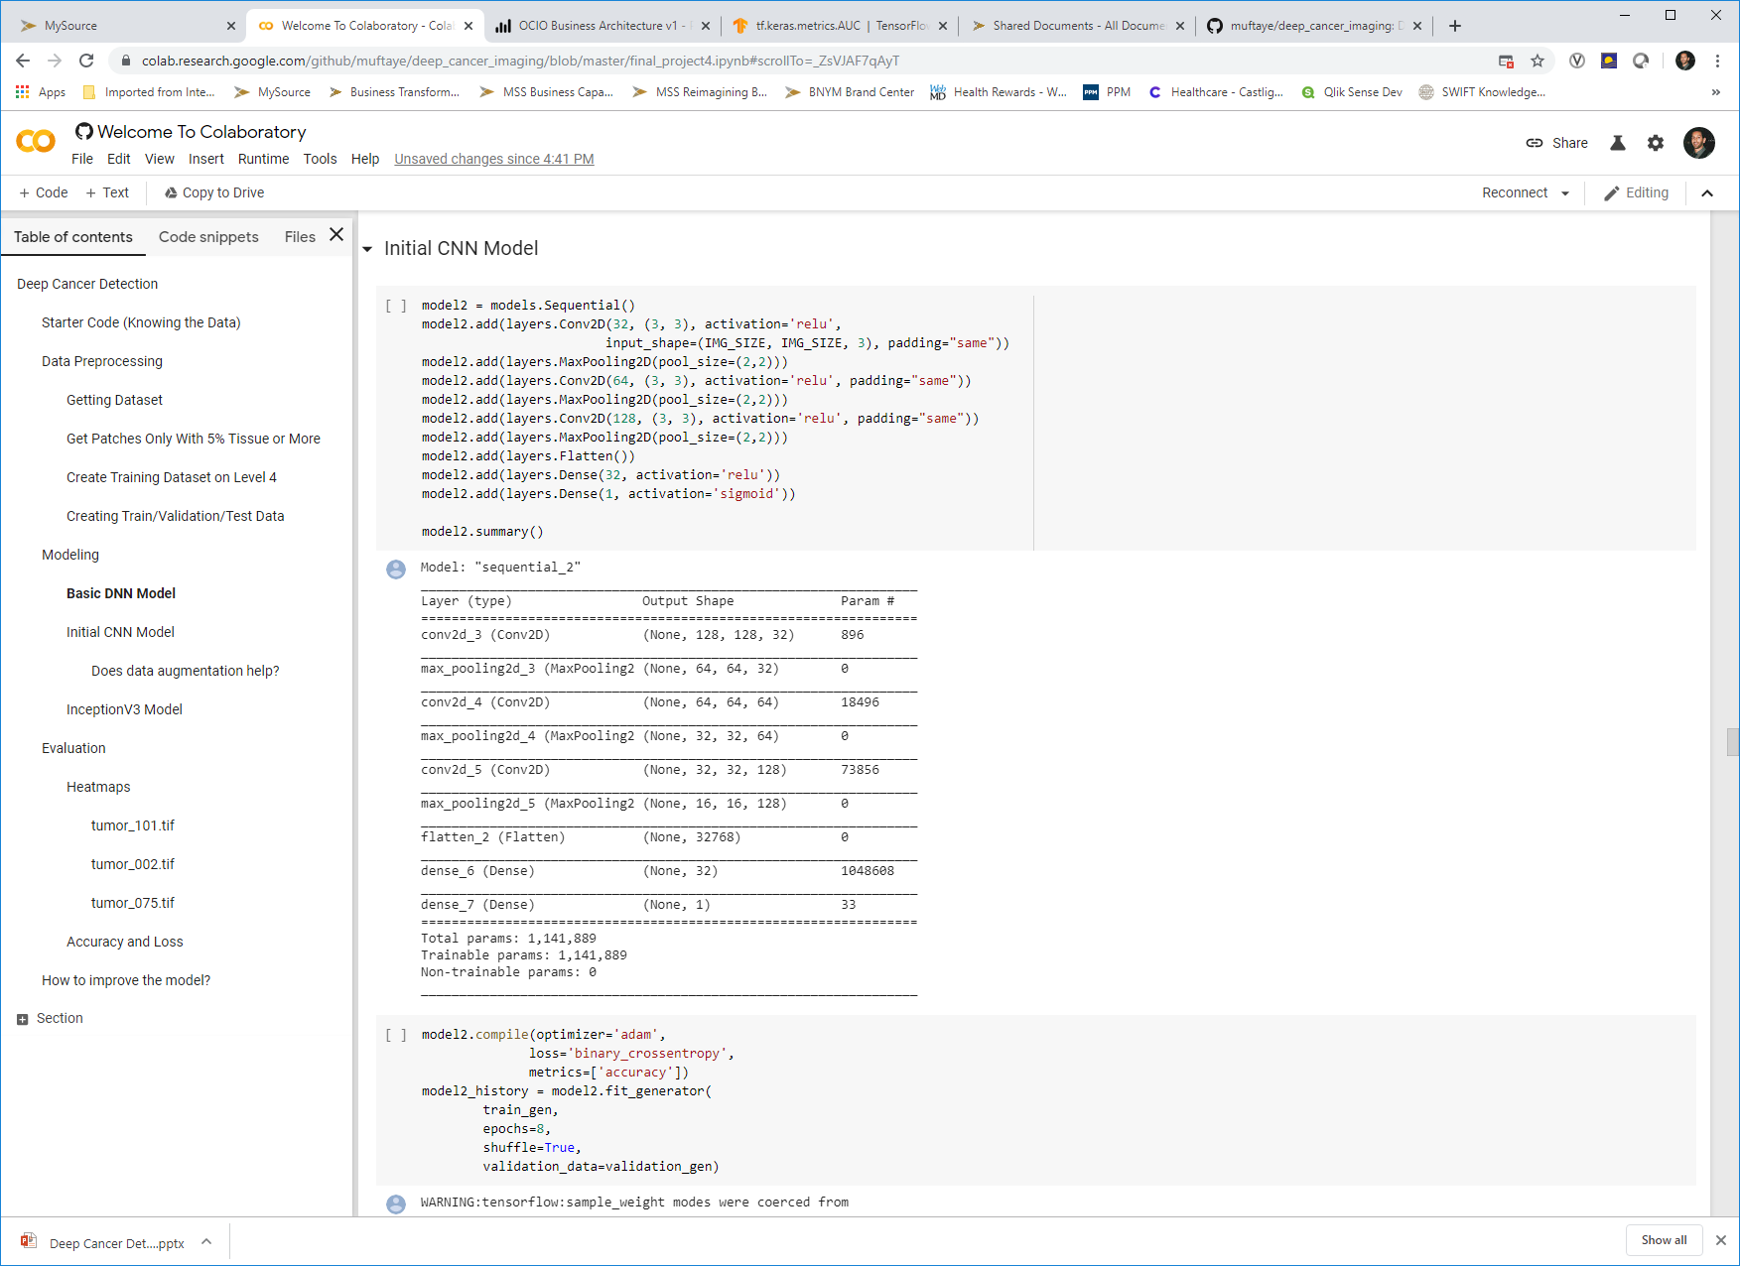
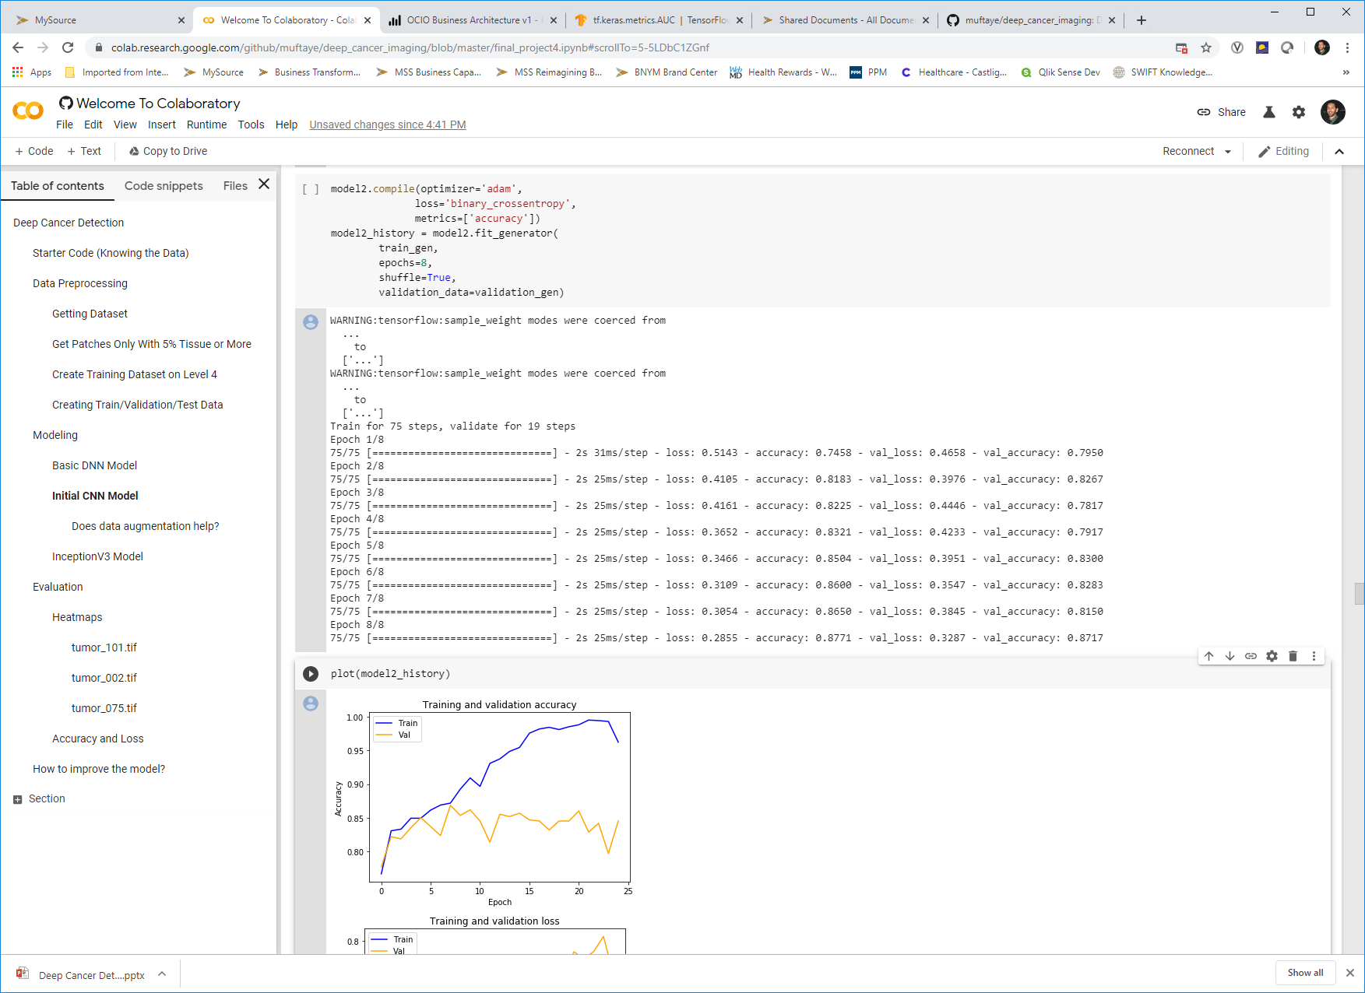
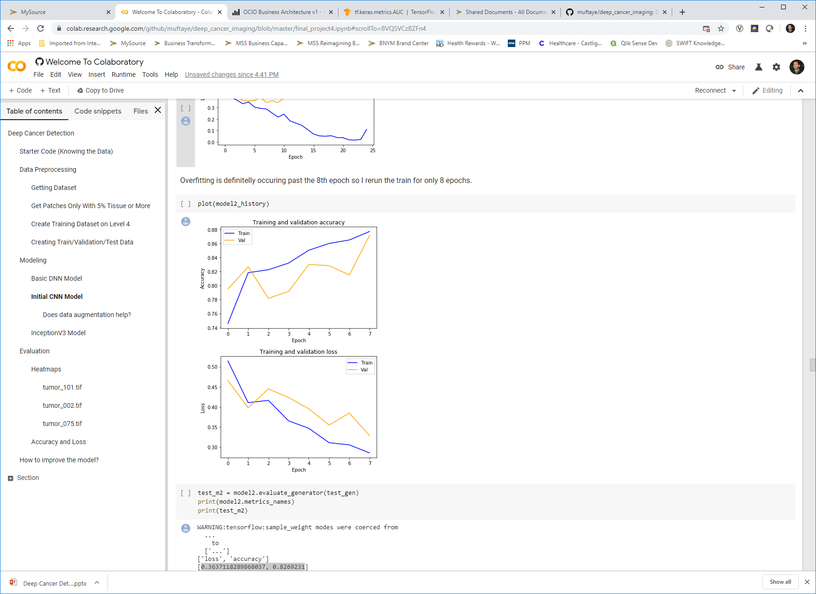
2nd Model – CNN
This model uses convolutional layers and pooling to enhance the model.

Slide 14
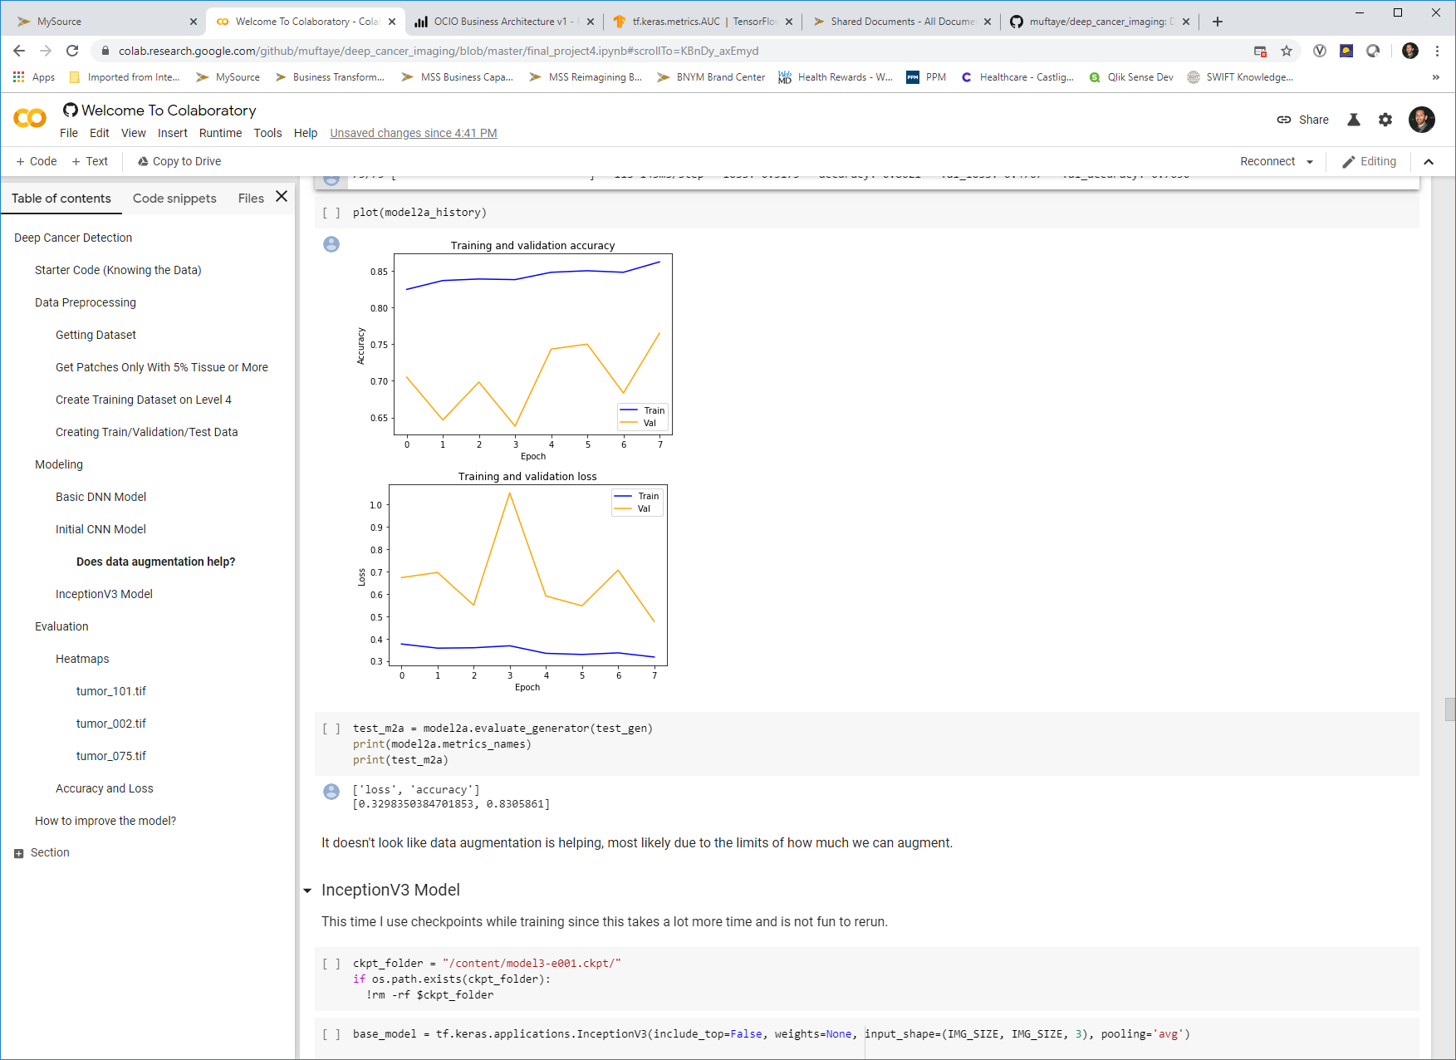
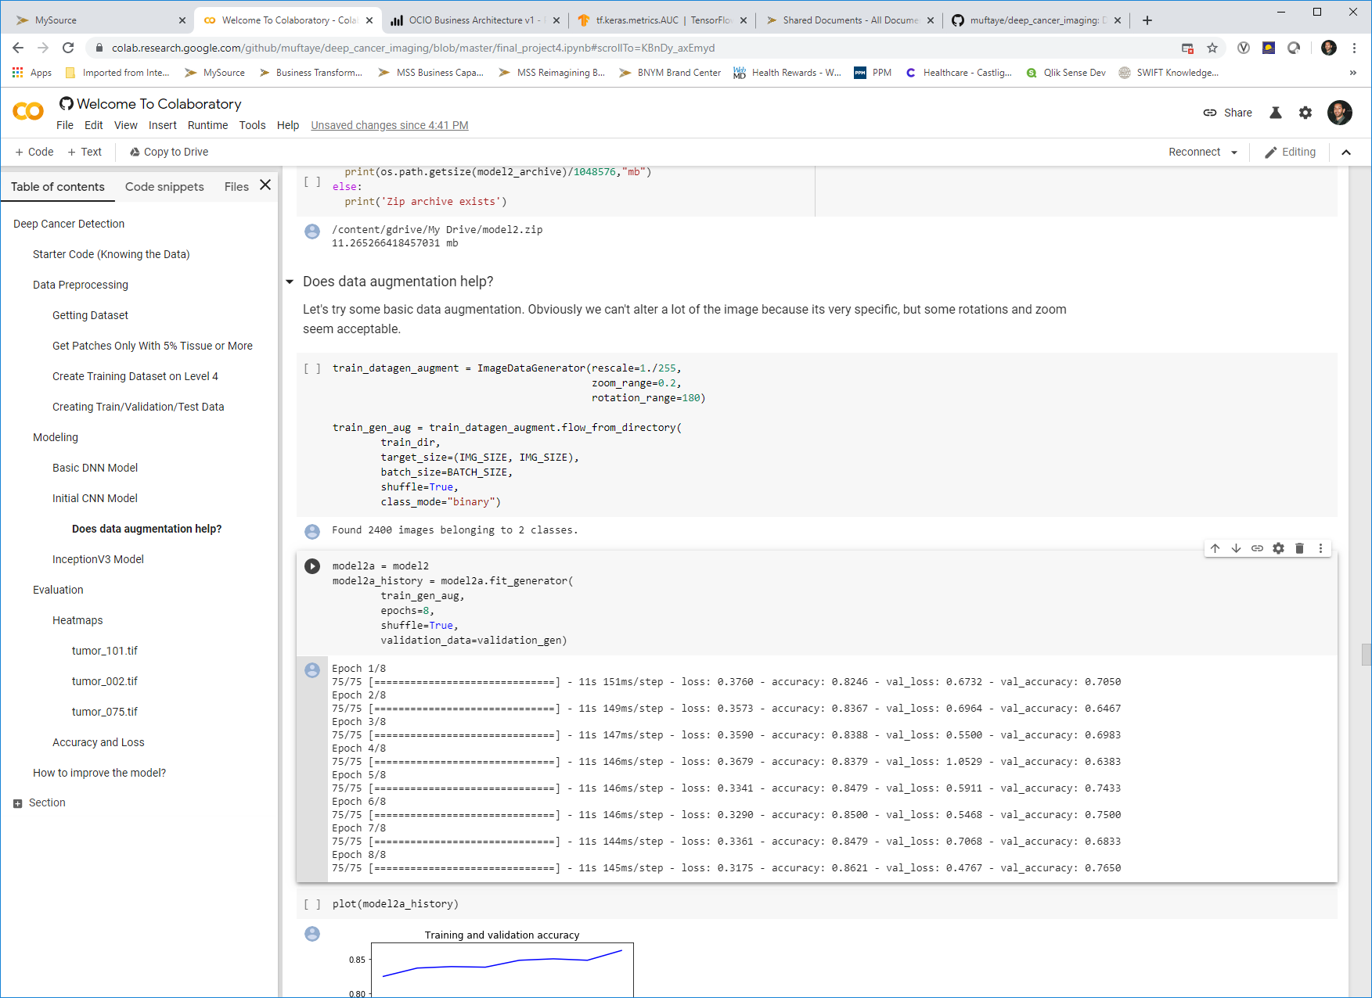
2nd Model – CNN with Data Augmentation
This model uses convolutional layers and pooling to enhance the model. I used zoom and rotation since these are ones that won’t impact the images and are actual augmentations that are common for this data.

Slide 15
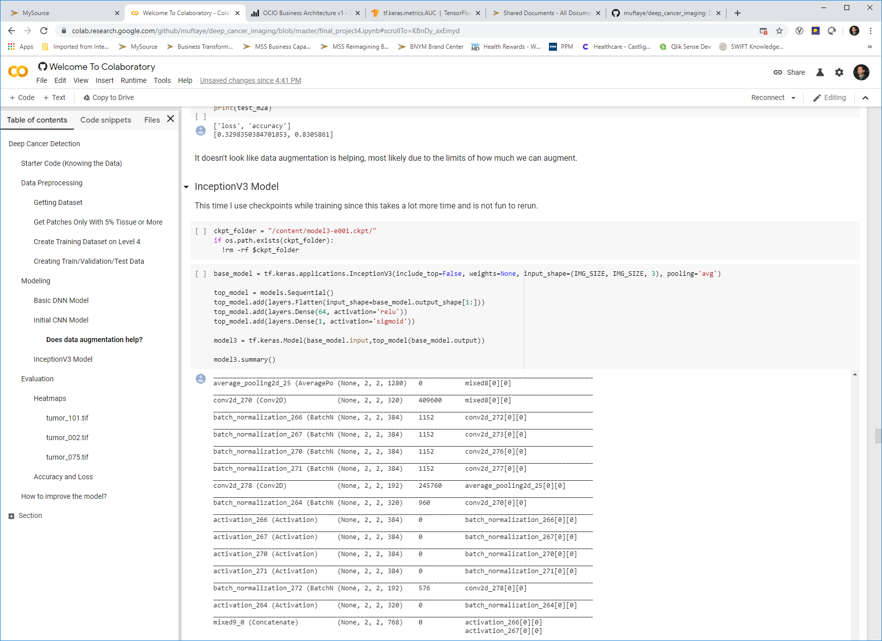
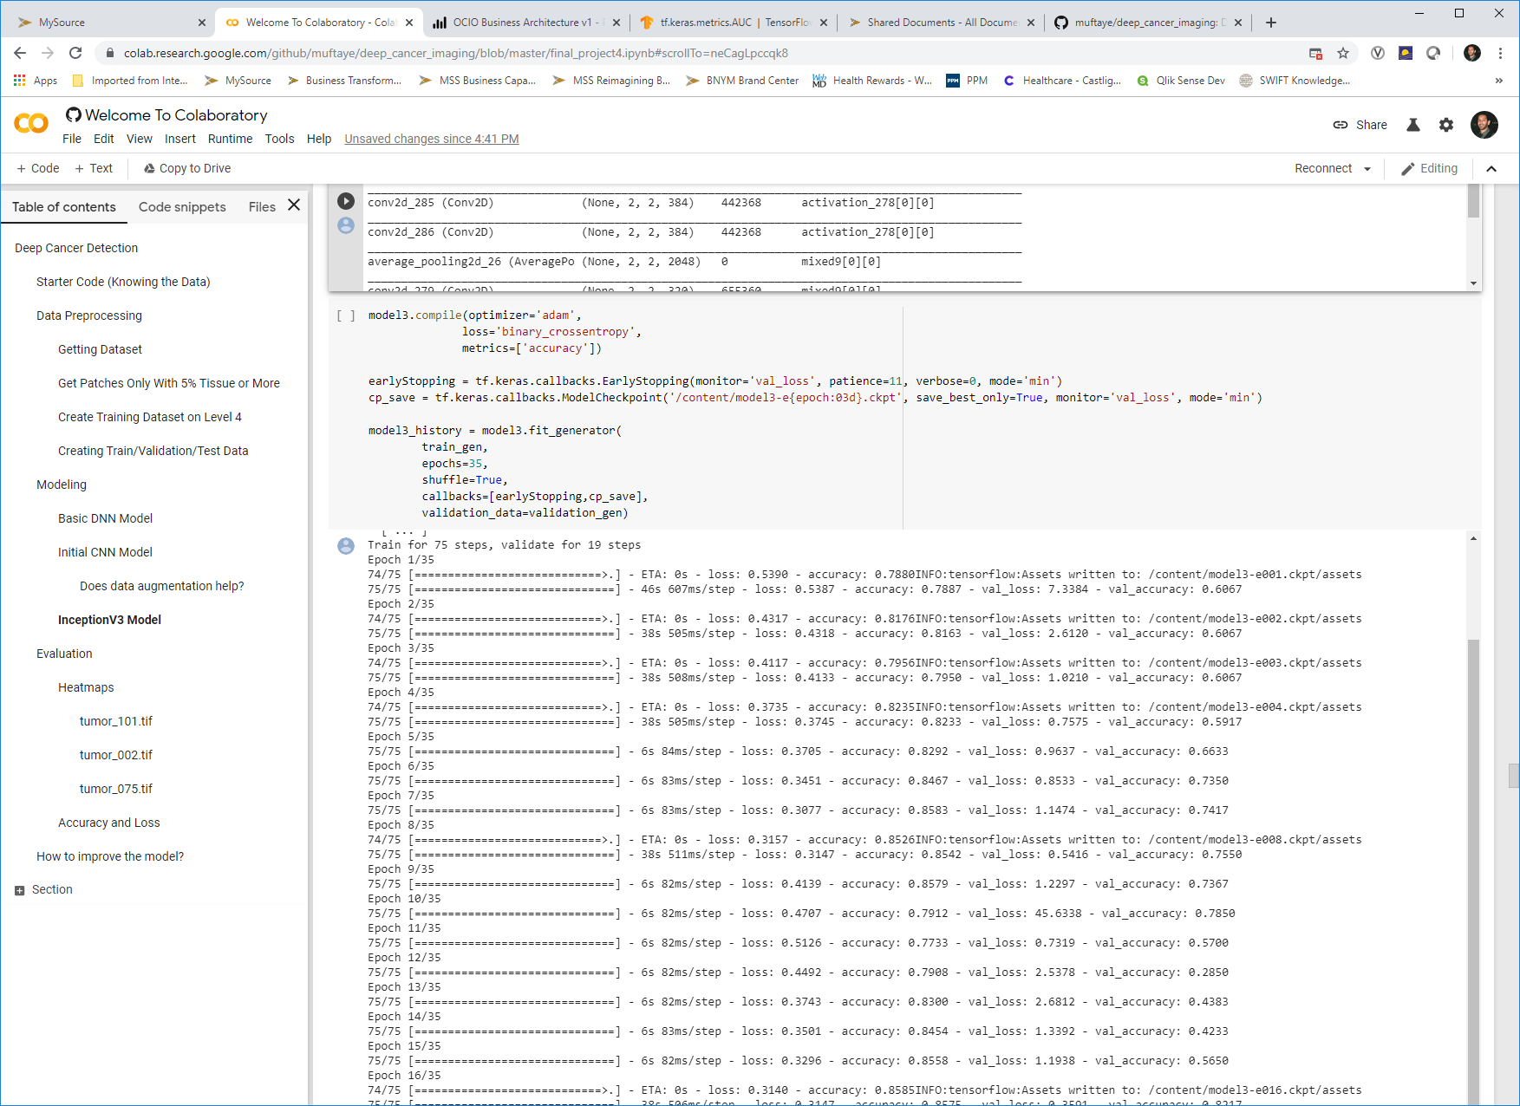
3rd Model – Inceptionv3
This model uses the InceptionV3 model and adds 2 dense layers in order to fit it for this project. I use checkpoints and early stopping callbacks for this model since it takes a lot longer to train.

Slide 16
Testing Results

Slide 17
All 3 Model Test Results
I chose 3 slides 002, 075 and 101 randomly from the dataset and set aside all patches for these to be used for testing. I used the evaluate method to get the test loss and accuracy and then also found the AUC for each.
The InceptionV3 model looks like it does best overall. I then used this model for my heatmapping.
Model | Test Loss | Test Accuracy | AUC
Model1 - Basic DNN | 0.573266 | 0.736721 | 0.796703
Model2 - Initial CNN | 0.363711 | 0.826923 | 0.869063
Model3 - InceptionV3 | 0.240251 | 0.929487 | 0.840027

Slide 18
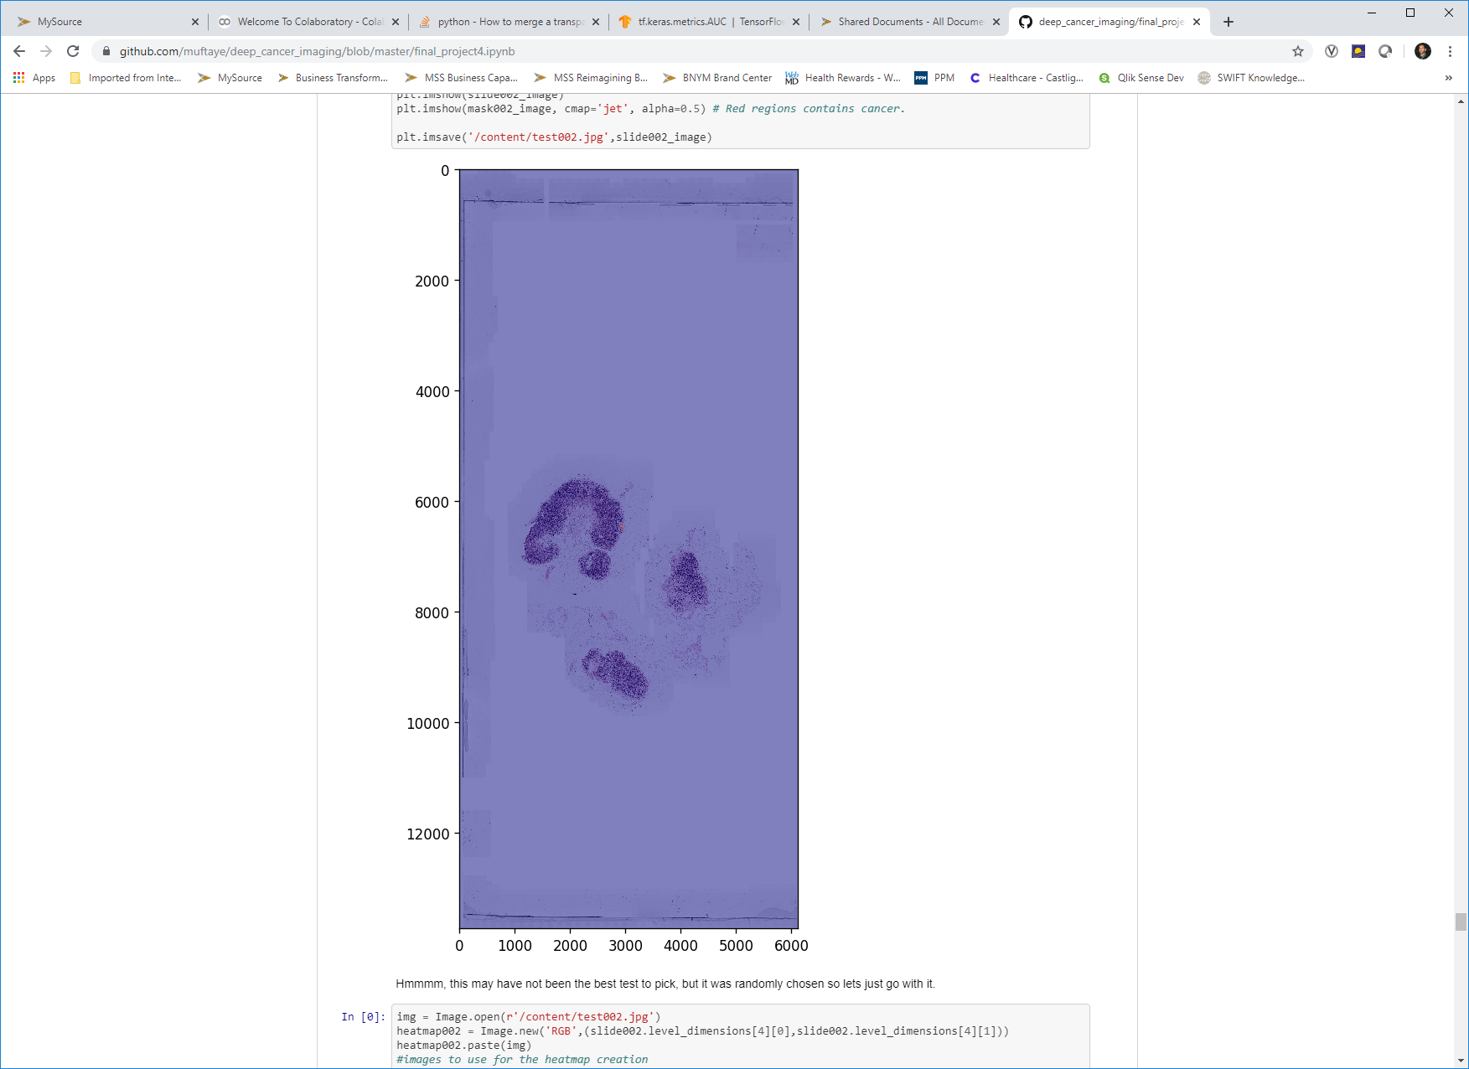
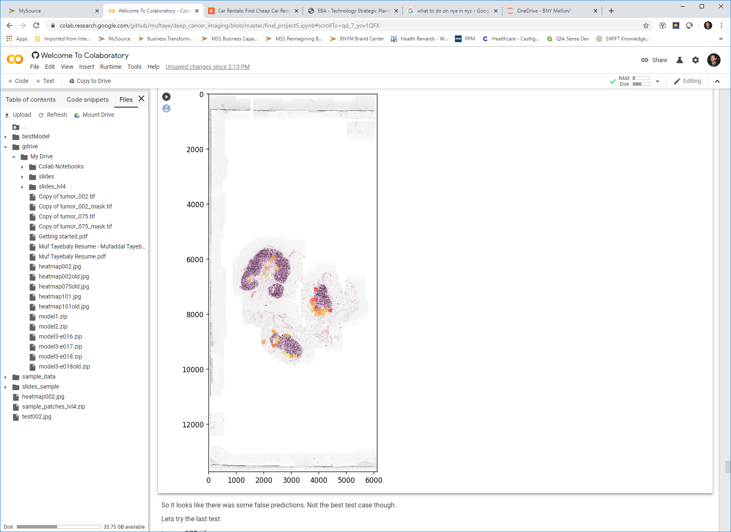
Model 3 – Heatmap 002
To create the heatmap, I superimposed the prediction of the patches over the slides and gave them different colors based on prediction. Since 0 = cancer and 1 = no cancer, anything that was <= .5 has a color. Yellow is lower chance cancer, where red is higher chance. This is not a good test since it only had 2 patches with cancer, but it was randomly chosen.
Actual
Prediction Heatmap

Slide 19
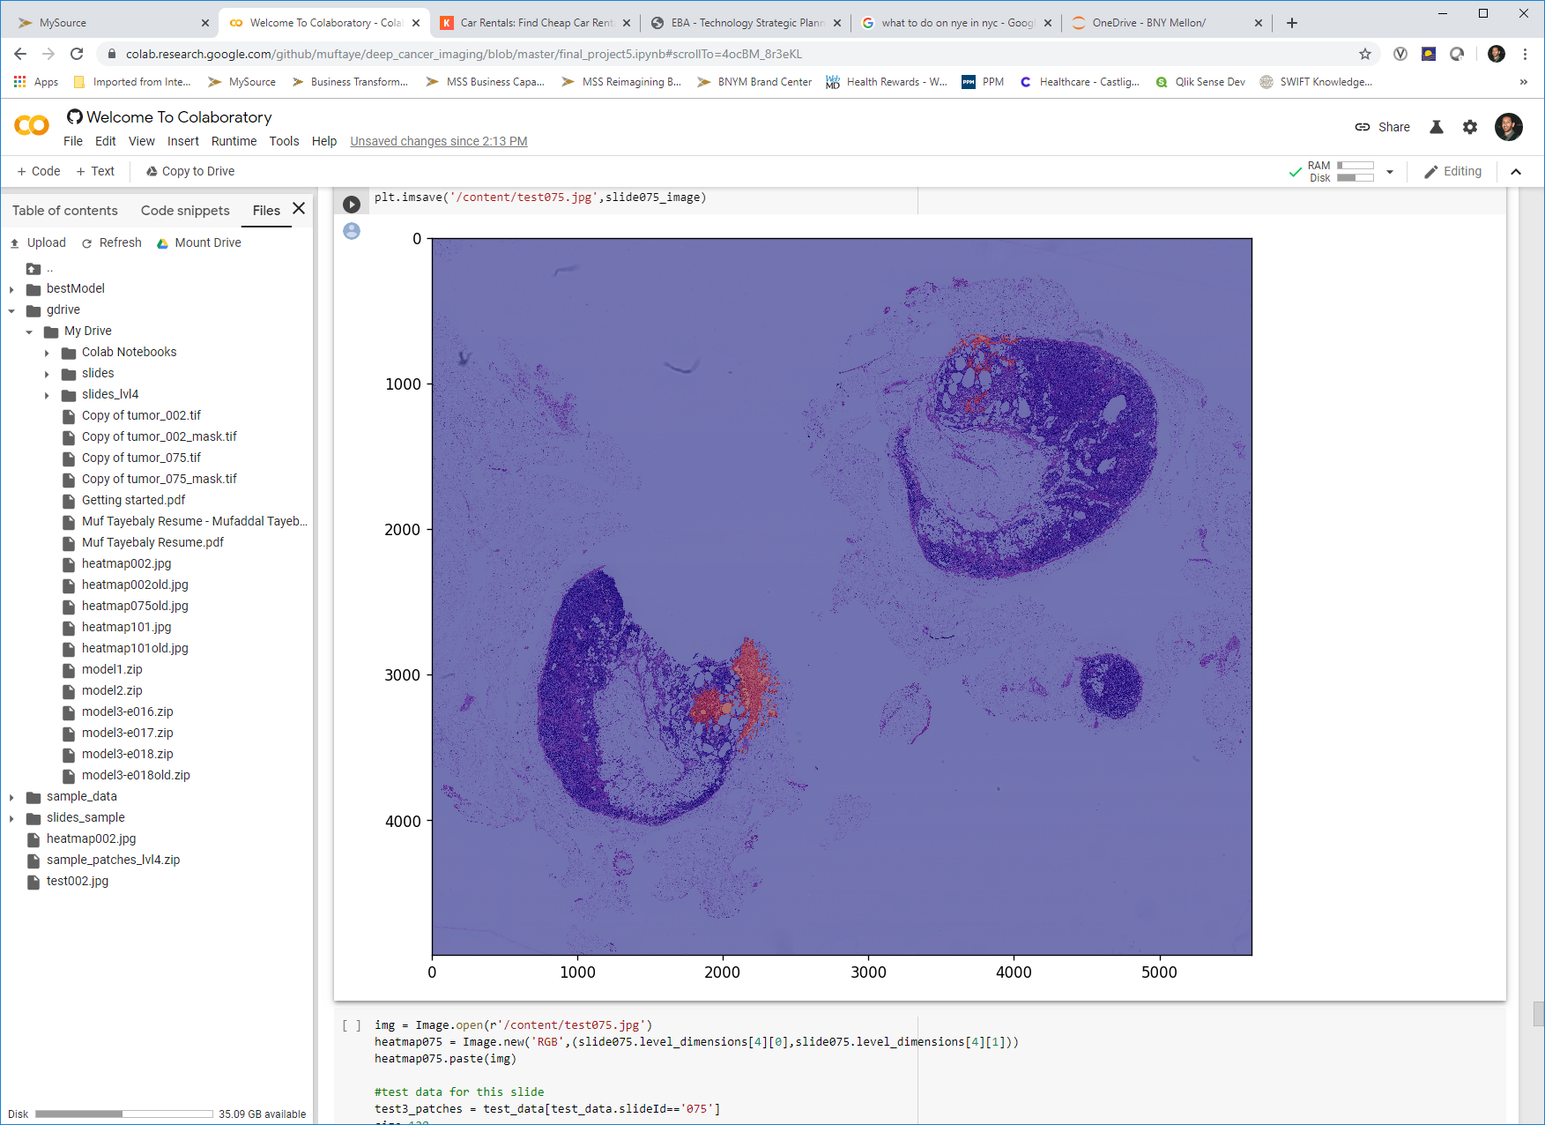
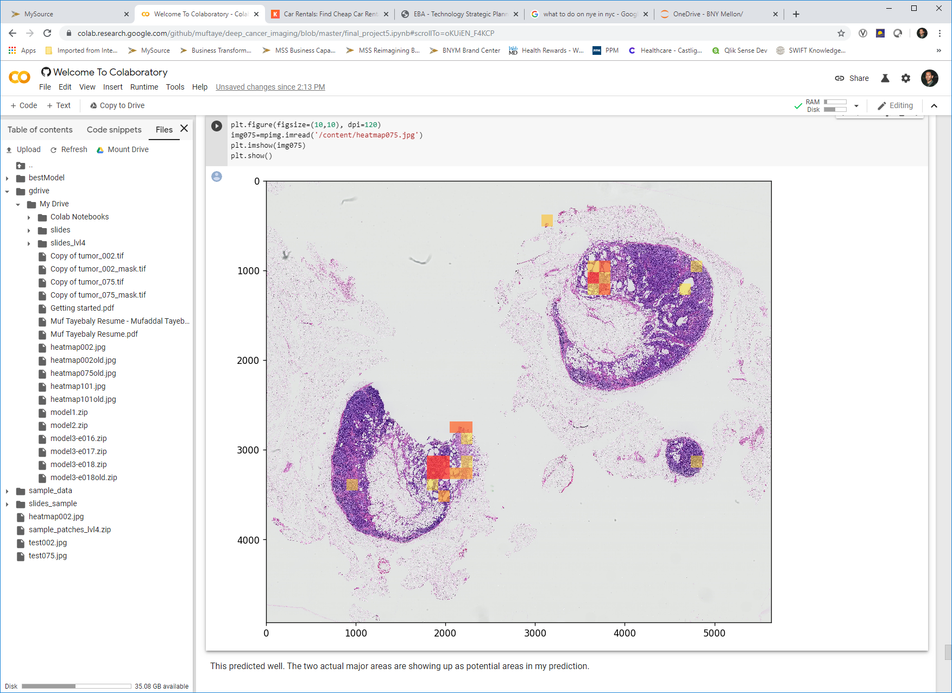
Model 3 – Heatmap 075
To create the heatmap, I superimposed the prediction of the patches over the slides and gave them different colors based on prediction. Since 0 = cancer and 1 = no cancer, anything that was <= .5 has a color. Yellow is lower chance cancer, where red is higher chance.
Actual
Prediction Heatmap

Slide 20
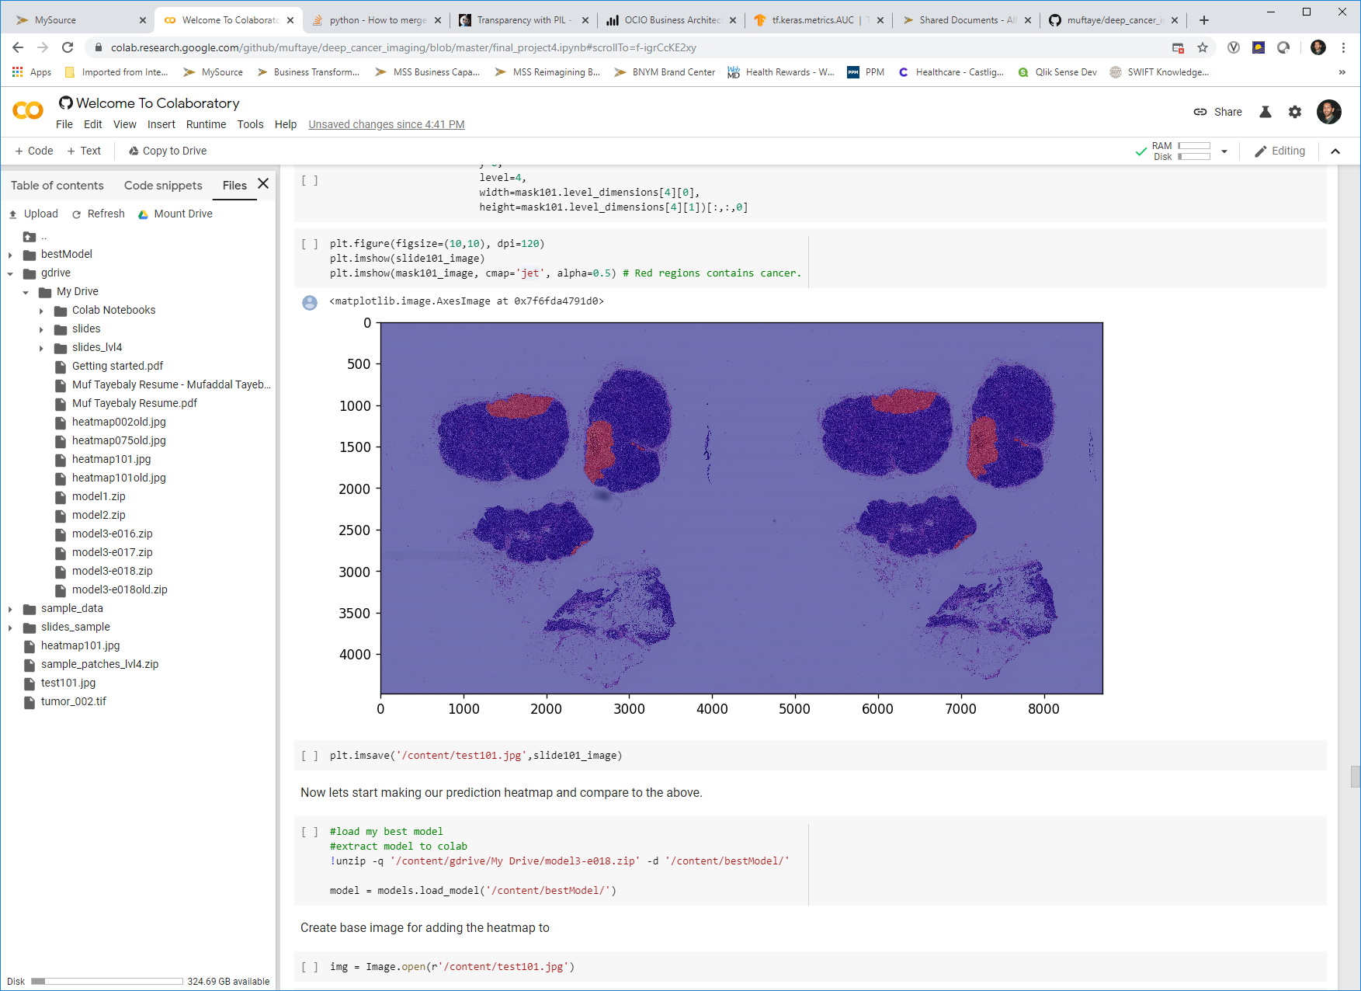
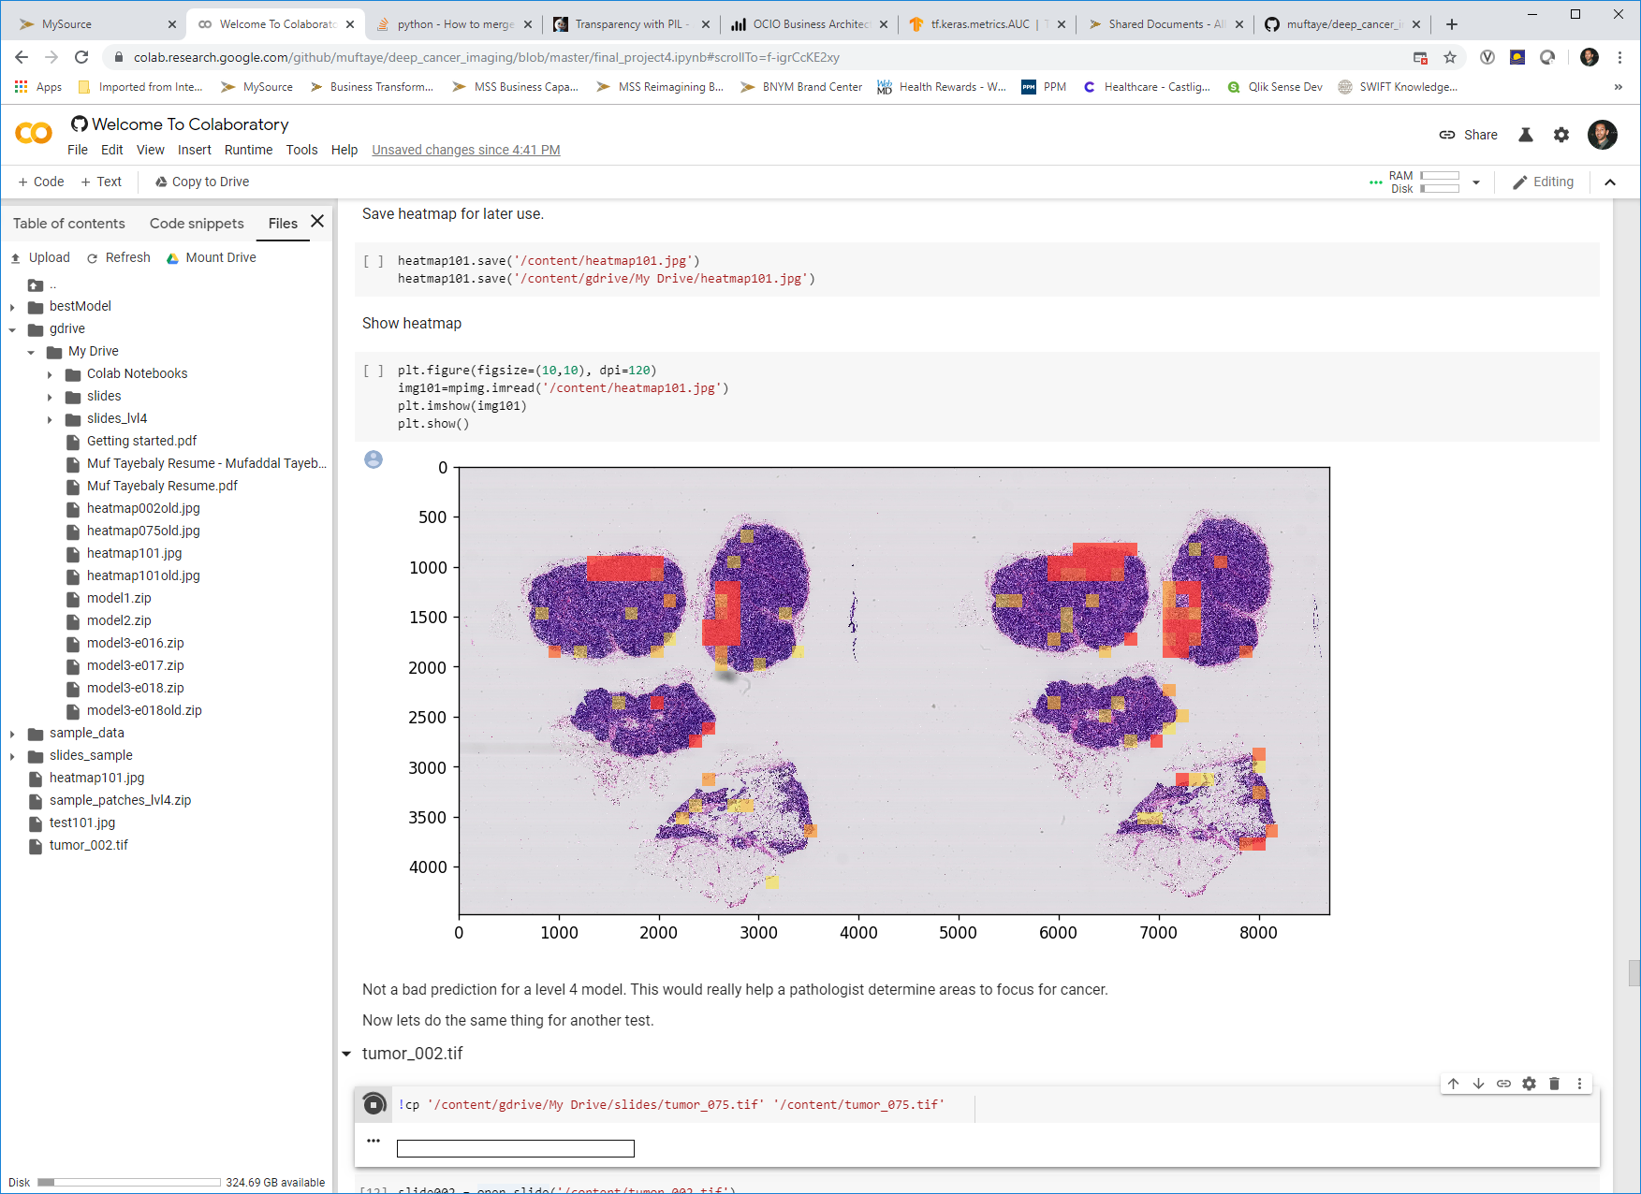
Model 3 – Heatmap 101
To create the heatmap, I superimposed the prediction of the patches over the slides and gave them different colors based on prediction. Since 0 = cancer and 1 = no cancer, anything that was <= .5 has a color. Yellow is lower chance cancer, where red is higher chance.
Actual
Prediction Heatmap

Slide 21
Conclusion

Slide 22
Conclusion
Out of the 3 models I created, the InceptionV3 looks to be the best and when we started evaluating it, it did a pretty good job identifying potential cancer cells.
The prediction heatmaps were not bad for the model I made. A pathologist would be able to use this to identify potential areas to revisit and pay close attention to when looking for cancer cells. If the pathologist has gone through the slide and did not find any cancer, but the prediction heatmap showed areas of cancer, this is a good indication the doctor needs to take another look and could help prevent misdiagnosis.
This is a good model to start. There are definitely areas to improve the model and really make a product out of this and sell it to medical institutions to operationalize as part of the pathologist slide reviews.

Slide 23
How to Improve?

Slide 24
How to Improve?
Based on what I have seen, I think the best way to improve the model is to use more zoom levels in the dataset. If I were to use a more zoomed in level for my 128x128 patches, I am sure the accuracy would improve. This would even result in more patches and would give us a bigger balanced data since we would have more cancer patches to work with.
Another way to improve the model is to try other training methods for the unbalanced dataset. I randomly chose certain non-cancer patches to work with since the dataset was so unbalanced and there are ways to work around that.

